Slide 1

Basho Training Riak 102 – Basic Anatomy
Professional Services
August, 2015

Slide 3
Riak Object
Key (Object Location)
Metadata
Value
Notes:
-- fundamental unit of replication

Slide 4
Key
(Object Location)
is actually:
Bucket Type + Bucket + Key
Notes:
-- a unique identifier for a data object (unique within a bucket)

Slide 5
Object Location
/types/users/bucket/basho/key/casey
Bucket Type
Bucket
Key

Slide 6
Metadata
Content-Type
Last Modified
Causal Context (version)
Custom Headers
Notes:
-- additional attributes of the data object
-- ex: content-type, vector-clock
-- arbitrary header

Slide 7

Value
(Payload is opaque to Riak)
{ JSON }
<XML>
Binary blob
Plain Text
Images
Serialized Binary Objects
Notes:
-- the payload for the data object
-- can be any format
-- binary blob as far as Riak is concerned
-- content-type is stored in metadata

Slide 8
Sample Object
key: employee_1
value: {"firstName":"John", "lastName":"Doe"}
metadata:
content-type: application/json
x-riak-vclock: a85hYGBgzWDKBVIsTNPi… ( <- causal context)
x-riak-my_tag: additional_info_to_store

Slide 9
Bucket
Logical Namespace for Objects
(A prefix for the key)
Example:
/buckets/user-profiles-basho/keys/user123
Notes:
-- a logical grouping of Riak Objects
-- a namespace
-- kinda like a table, but not really like a table in any way
-- shared configuration for Objects

Slide 10
Bucket Types
Namespace for Buckets
Way to store custom configs/settings
Data types
Search indexes
Commit hooks
etc
/types/profiles/buckets/user-profiles-basho/keys/…
/types/profiles/buckets/user-profiles-github/keys/…
Notes:
-- a logical grouping of Riak Objects
-- a namespace
-- kinda like a table, but not really like a table in any way
-- shared configuration for Objects

Slide 12

Node
Notes:
-- an instance of Riak
-- an Erlang VM
-- almost always running on a separate server

Slide 13
Cluster
Notes:
-- a group of Riak nodes connected to each other
-- almost always in a single datacenter
-- as a whole, the cluster can be thought of as ‘the database service’

Slide 14
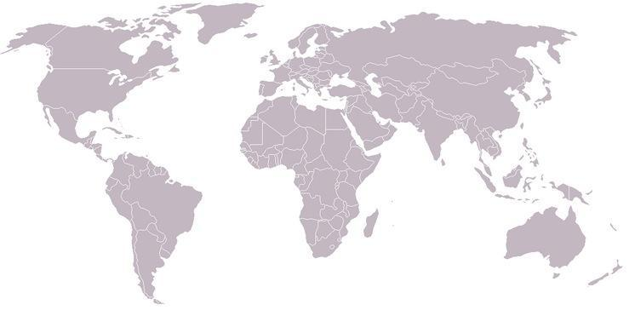







Data Center
Riak KV Enterprise automatically replicates data between clusters
Basho Technologies | 15
Notes:
Clusters can sync to each other using MDC Repl
Realtime sync + Full

Slide 15
Anatomy
Riak KV Object (Key, Metadata, Value)
Bucket (namespace)
Bucket Type (shared config)
Node
Cluster
Multiple Data Centers
Notes:
Recap

Slide 16
Operations
Key/Value CRUD
Queries
Data Types API
Notes:
-- ways to interact with Riak Objects

Slide 17
Key / Value
by Key (Object Location)
POST / PUT / GET / DEL
HEAD (to check existence / get metadata)
Eventual Consistency vs. Strong Consistency
Notes:
-- Simple direct lookup by unique primary key
-- Create / Read / Update / Delete objects, also HEAD requests can be performed to check for existence or get metadata

Slide 18

Search Query
Index JSON/XML/text documents
Or, index ‘Tags’ on binary blobs
Query by fields (string, int, date, …)
Range queries
Boolean/composite queries
Geospatial

Slide 19
Data Types
Counters: Increment/Decrement
Sets: Add/Remove elements
Maps:
Update Registers (strings)
Toggle Flags (boolean)
Also: Counters, Sets, nested Maps
Notes:
Data Types (CRDTs) have their own API, depending on the types

Slide 20
Recap
Objects
Bucket Types / Buckets
Nodes / Clusters / Multiple DCs
Operations
Key/Value
Search Query
Data Types

